Slide 1
Modern Analytics Academy
Data Acquisition and Storage
https://aka.ms/maa

Slide 2
Agenda
The Team
Schedule
Acquiring analytical data
Decision Criteria
Demo

Slide 3
Modern Analytics Academy Team
Alex Karasek
Annie Xu
Brian Hitney
Chris Mitchell
Jason Virtue
Senior Cloud Solution Architect
Senior Cloud Solution Architect
Senior Cloud Solution Architect
Principal Cloud Solution Architect
Principal Cloud Solution Architect
https://aka.ms/maa

Slide 4
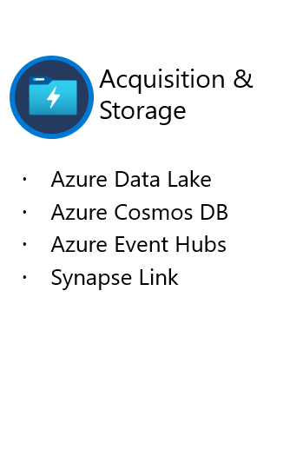
Academy Sessions
Acquisition & Storage
Modeling
Pipelines
Security & Governance
Visualization
Azure Data Lake
Azure Cosmos DB
Azure Event Hubs
Synapse Link
Data Lake Structure
Synapse Spark Pools
Synapse SQL Pools
Synapse Serverless SQL
Azure Data Factory
Synapse Pipelines
Power BI Dataflows
Azure Stream Analytics
Auditing
Security
Azure purview
Power BI
Paginated Reports
Power BI Embedded

Slide 5
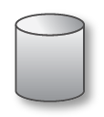
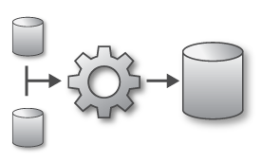
Modern Analytics in Azure
LOB
INGEST
EXPLORE
PREP & TRAIN
MODEL & SERVE
CRM
BI + Reporting
Graph
Advanced Analytics
Query All Data
Analytics Engines
Data Warehouse
Image
Real Time Analytics
Data Orchestration and Monitoring
Social
STORE
Big data store
IoT
METADATA MANAGEMENT & GOVERNANCE
Cloud
Notes:
For those who may not have attended our overview session, I want to take a moment looking at what a modern analytics solution may look like when it is realized in Azure.
Ingestion – we need to be able to connect to the data no matter where it comes from. Line of business applications, cloud services, social networks, sensor networks.
Storage - highly scalable and cost effect storage is critical to these solutions, data lakes make it possible to store theoretically limitless amounts of data making it more about what you decide to throw away than what you keep
Exploration – data processing engines and services are used more for ad hoc data exploration of data
Prep & Train - New analytics and data processing engines such as Spark are being leveraged to prepare data and train models over large data volumes
Model & Serve – Without giving users access to the data to do ad-hoc analysis an analytics solution is useless. We must surface the data in a useable way through modern tools.
Metadata management & governance – with all this data security and regulatory concerns haven’t gone away, data must be discoverable, compliant, and trusted.
For our conversation today we’re going to be focusing on this portion of the diagram. While I may dabble in the “explore” section this will only be to illustrate concepts that I’ve shown as part of “ingest”.

Slide 6
Variants of Cloud Data Storage
File Storage – A file share. For our purposes Azure Blob Storage
Database Storage – A traditional RDBMS. Examples include Azure SQL, MySQL, PostgreSQL and MariaDB
Event Storage – A message queue. Examples include Azure Event Hubs, Azure Storage Queues, Azure Service Bus
NoSQL Storage – A document database. Examples include Azure Cosmos DB, Azure Table Storage
Notes:
For this discussion its important for us to define some terms and patterns for types of storage. We’re going to examine four distinct types of storage.
File Storage is probably the most well understood form of storage so we probably don’t need to spend a lot of time here. While there are a few different variants of “file oriented” storage in the cloud the one we’ll really examine is Azure Blob Storage. The other types of storage like azure files are somewhat specialized for other workloads.
Database Storage is also likely a pretty well understood topic, but I think I should call out that we’re specifically talking about traditional transactional databases here. There are several different types of traditional databases available as managed services in Azure, and picking one over the other often is a matter of preference or due to version/feature support. Inside Azure SQL, MySQL, PostgreSQL and MariaDB are all flavors available in our database service.
Event Storage is quite a bit different, unlike files or databases event storage includes technologies like service bus, azure storage queues and event hubs. These technologies are typically designed to support loosely coupled applications, and in analytics solutions they’re used as a high throughput buffer for data used for real-time solutions (ie. IOT)
NoSQL databases often referred to as “document” databases are designed to break some of the classic challenges with traditional databases.
With this background lets dig deeper into these variants of storage to look more at what each one does and why and where it should be used.

Slide 7
Blob Storage
All operations at the File Level
Authentication via AAD or Secure Token
Security at the file and/or folder level
Supports HTTPS and WebHDFS protocols
Does not enforce schema on files
Notes:
Many traditional data warehousing solutions would primarily receive data via a series of files. These files were often pushed by source systems to a network share for consumption by ETL processes. This approach solved many purposes including:
ETL Processes could remain ignorant of driver versions and other factors at the source system.
Source systems were insulated from unexpected query load form downstream systems.
In the event of issues in ETL processes could be rerun without impacting downstream systems.
This fundamental approach is “time honored’ and still in use today in modern analytics solutions. However, adding the cloud to this pattern adds some new capabilities and twists including new protocols for IO like WebHDFS. However, the core fundamentals of a “file based” system for moving data still exist. The core things to consider include:
The point of transactional durability and security is at the file level.
While there is nearly always some sort of “implied” schema within the file, the storage does not enforce schema.
A classic way to think of this is fast writes, slow reads. Your writes are fast because there is no transaction manager keeping up with intermediate state in order to do a point in time restore or rollback like a transactional database. However your reads are slow because you need to apply any schema at read time. You don’t get the benefit of enforced data types, indexes or any thing else to increase the speed of reads. The only real benefit you’ll get at read time is any compression you may have applied to the files, and also any logical structure than can be inferred from the file paths/naming.

Slide 8
Durability Options: Blob Storage
Typically >300mi
Typically >300mi
Zone 1
Zone 2
Zone 3
Async
Async
Primary
Secondary
Primary
Secondary
LRS
3 replicas, 1 region
Protect against disk, node, rack failures
Write is ack’d when all replicas are committed
Superior to dual-parity RAID
11 9s of durability
ZRS
3 replicas across 3 Zones
Protect against disk, node, rack and zone failures
Synchronous writes to all 3 zones
12 9s of durability
GRS
6 replicas, 2 regions (3/region)
Protects against major regional disasters
Asynchronous to secondary
16 9s of durability
RA-GRS
GRS + Read access to secondary
Separate secondary endpoint
RPO delay to secondary can be queried

Slide 9
Database Storage
Transactions can span multiple operations – Create, Read, Update, Delete (CRUD)
Security at the database, object, and row level
Connectivity via a variety of protocols like Tabular Data Stream (SQL Server)
Strict schema enforcement

Slide 10
Durability Options: SQL
Single logical database
DB
P
S
Ack
value
Read
write
P
S
P
Recovery from machine failure
Critical capabilities:
Create new replica
Synchronize data
Stay consistent
Detect failures
Failover
99.99% availability
Ack
Write
S
Write
Ack
S
Reads are completed at the primary
Writes are replicated to secondaries
Notes:
Relational databases are designed for transactional operations where Atomic Consistent Isolated Durable (ACID) rules are followed. Databases have been providing these capabilities for years. Under the covers database platforms typically use a combination of datafiles and a transaction log to maintain this consistency. Azure capitalizes on this design pattern by leveraging the transactional nature of SQL databases to keep 3 active copies of your database at all times. In the event of a hardware outage Azure will seamlessly failover to another copy of your database maintaining operations for you.

Slide 11
Event Storage
Real time high throughput message sink
Not intended for permanent storage
Operations at the message level
Security at the queue level
Supports AMQP, Kafka and HTTPS protocols
No schema enforcement
Can persist to blob storage via “capture”

Slide 12
NoSQL Storage
Tuneable transactional consistency
Designed for massive scale
Flexible schema
Operations at the document level
Supports Multiple API protocols
SQL – default
Mongo DB
Cassandra
Graph
Table Storage
Can persist to analytics storage via Synapse Link

Slide 13
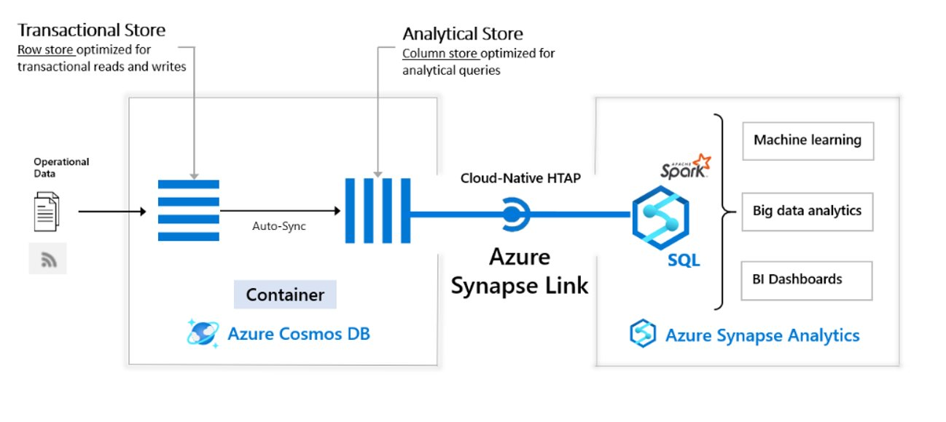
Azure Synapse Link for Cosmos DB
Notes:
Relational databases are designed for transactional operations where Atomic Consistent Isolated Durable (ACID) rules are followed. Databases have been providing these capabilities for years. Under the covers database platforms typically use a combination of datafiles and a transaction log to maintain this consistency. Azure capitalizes on this design pattern by leveraging the transactional nature of SQL databases to keep 3 active copies of your database at all times. In the event of a hardware outage Azure will seamlessly failover to another copy of your database maintaining operations for you.

Slide 14
Selection Criteria
Data IO Pattern
Does the data come in scheduled batches or events?
Is the data write / append only, or transactional?
Security needs
Is role-based security required?
Is AAD Authentication required?
Latency / Resiliency
How much latency can be tolerated?
How are outages handled?
Is there a need for sophisticated backup/restore capabilities?

Slide 15
Data Storage Decision Criteria
Batch Oriented
Message Oriented
Rich Transactions
File Storage
Database Storage
Event Storage
NoSQL Storage
Notes:
What we’re looking at here is a general comparison of the aspects of each of these styles of storage, and more importantly how this might impact your selection criteria for using them in your overall “data acquisition” design.
For file storage, as we’ve called out previously, this is a classic example of “batch“ architecture. At some regular cadence you receive one or more files that you then process downstream. Some could argue if each file represented a single transaction wouldn’t this no longer be a batch solution. While that is technically true, that pattern is really more akin to a messaging architecture. Regarding transactions each individual file write succeeds or fails by itself, if there is a need for a series of files to succeed or fail together that must be managed outside the code and the file storage cannot do anything to prevent reads after a file is written.
For database storage, records can be written in either singleton fashion or batch, so this is the one solution that allows you a mix of both event and batch oriented writes. However, its important to consider that in order to use a database as an event architecture you’d need to do polling which is not considered a best practice. More often than not a database is used in an analytics architecture where there is a need for some level of multi-step transaction from a LOB system that is feeding your upstream analytics solution.
Event systems really shine when volume and latency

Slide 16
Demo: Acquiring data in Azure

Slide 17
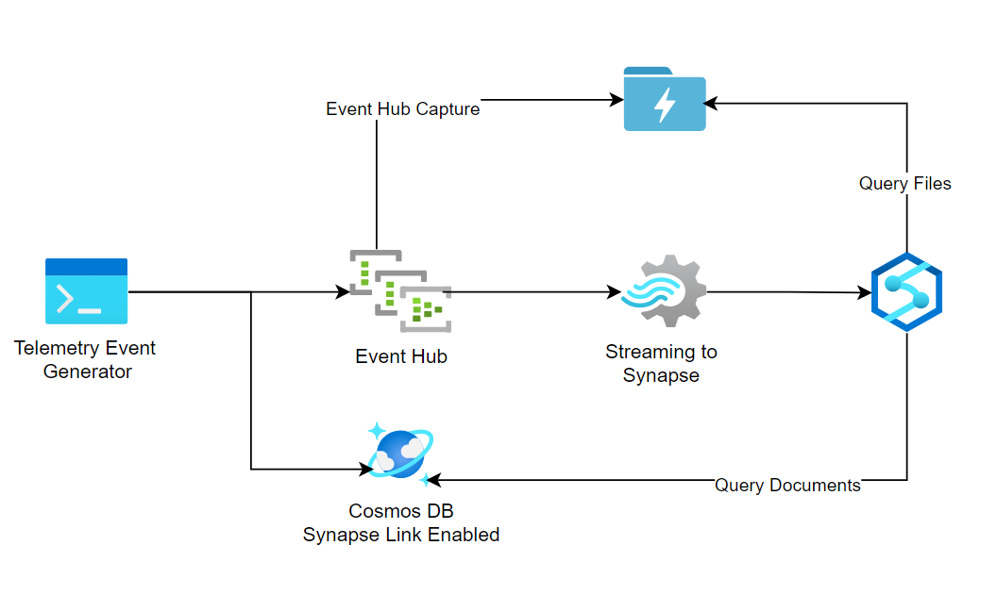
Demo: Architecture

Slide 18
Thank you

